Slide 1
ASSIGNMENT
Case study of any two leading Cloud innovators
Made by: Yusuf j
KTC Hubli

Slide 2
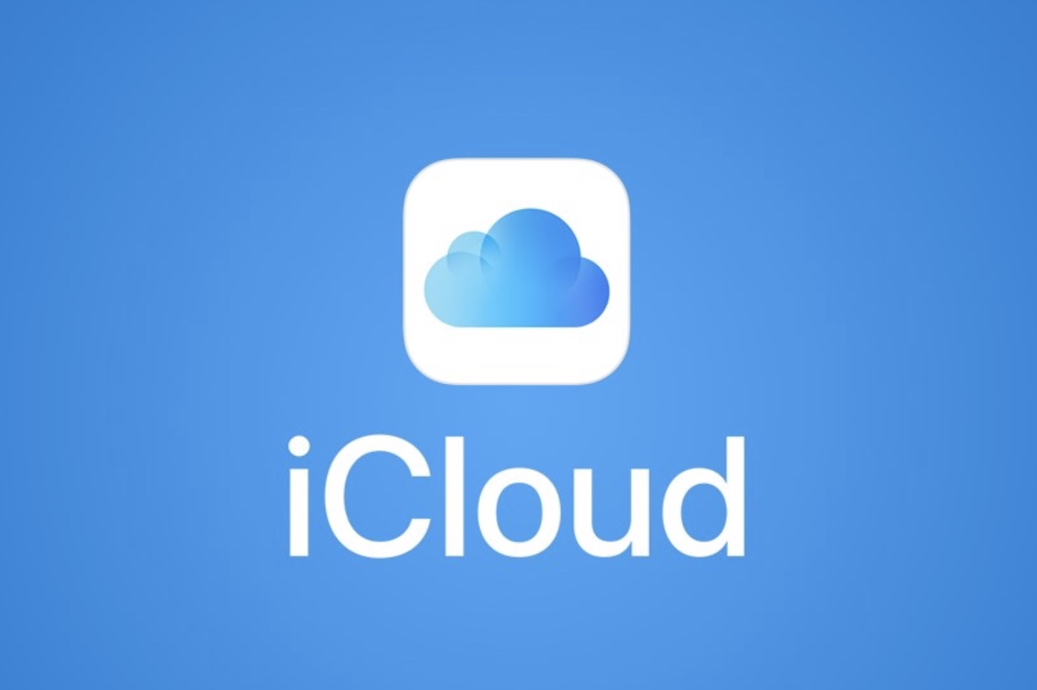
1) iCLOUD

Slide 3
Introduction
Icloud is a cloud storage and cloud computing from Apple launched on october 12 2011.
The service allows users to store data such as music or ios applications.

Slide 4
Content everywhere
Anything you purchase from the iTunes Store, App Store, and iBooks Store is automatically available on all your devices. You can also access past purchases from any of your devices.

Slide 5
Basic Features of iCLOUD
The cloud-based system allows users to store:
Music
Photos
Applications
Documents
Bookmark
Reminders
Backups
Ibooks
Contacts and provides apalt form for Apple’s email
Services and Calendars

Slide 6
Photos and Video
iCloud service which allows users to store the most recent 1,000 photos on the iCloud servers up to 30 days free of charge. When a photo is taken on a device with Photo Stream enabled, it is automatically uploaded to the iCloud servers; from there, it is automatically pushed to the rest of device you have got.

Slide 7
Find My iphone
Allows users to track the location of their ios device or Mac. Auser can see the device’s approximate location on a map and display a message or play a sound on the device (even if it is set to silent), change the password on the device,and remotely erase its contents.

Slide 8
iCloud Key-chain
Keeps website, credit card, and Wi-Fi account information up to date across your iOS devices and Mac computers. It also keeps Internet account names, passwords, and settings up to date on your Mac computers.

Slide 9
Find My Friends
Find My Friends is very similar to Find My iPhone, except users can share their location with other friends or family using the feature.
iOS 6 added location-based alerts to notify the user when a device arrives at a certain location

Slide 10
Backup and restore
iCloud automatically backs up your iOS device daily over Wi-Fi when your device is turned on, locked, and connected to a power source. You can use your iCloud backup to restore your iOS device or set up a new one.

Slide 11
Music , Movies ,Books
With iCloud, anything you purchase in the iTunes Store, the App Store, and iBooks is automatically available on all your devices the moment you tap Buy. You can also access past purchases from any of your devices. And whenever you start something on one device, all your other devices automatically remember where you left off.

Slide 12
Why do we need iCLOUD

Slide 13
Back to My Mac
Control your remote Mac just as if you were sitting in front of it. Screen sharing opens a window displaying the desktop of your remote Mac. You can use your mouse and keyboard to open applications, edit documents, and more.

Slide 14
Advantages
Don't have to use a USB chord to sync information
Pushes all your information to listed devices .
Makes it easier to sync information when you get a new device
It's free to get 5GB of storage
Easier access to information

Slide 15
Disadvantages
iCloud service is compatible only with IOS devices and has widespread accessibility issues.
iCloud will only keep new photos for 30 days using the iPhone
iTunes has to be open in order to sync music, apps, etc.
Possible security issues when you have multiple devices synced to one account.

Slide 16
Conclusion
Apple's iCloud can automatically synchronize data from Macs, PCs and iOS devices, which can help people who are forced to deal with multiple computer worlds.

Slide 17

2) GitHub

Slide 18
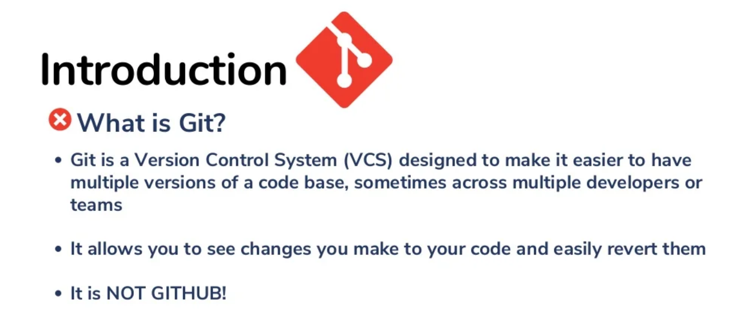

Slide 19
What is Github?
Github.com is a website that hosts git reposotories on a remote server
Hosting reposories on Github facilitates the sharing of codebases among teams by providing a GUI to easily fork or clone repos to a local machine
By pushing reposotories to Github,you will pretty much automatically create your own developer portfolio as well

Slide 20
History About Github
GitHub is a popular web service that facilitates users to host their code online and share it with others for collaborative development. As of 2017, GitHub seems to host over 67 million repositories by 24 million developers and is used by over 117,000 businesses worldwide. Development of the GitHub.com platform began on October 19, 2007.The site was launched in April 2008 by Tom Preston-Werner, Chris Wanstrath, P. J. Hyett and Scott Chacon after it had been made available for a few months prior as a beta release.[14] GitHub has an annual keynote called GitHub Universe.[15] As of November 2021, GitHub reports having over 73 million developers and more than 200 million repositories

Slide 21
METHODOLOGY
• Create a branch. Create a branch in your repository.
• Make changes. On your branch, make any desired changes to the repository.
• Create a pull request. Create a pull request to ask collaborators for feedback on your changes.
• Address review comments.
• Merge your pull request.
• Delete your branch.

Slide 22
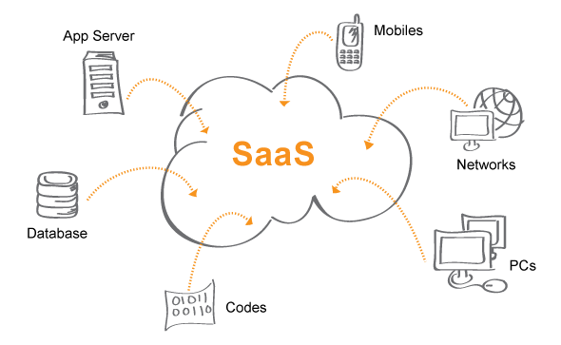
MODELS USED IN GITHUB
It is a software-as-a-service (SaaS) business model, was started in 2008 and was founded on Git, an open source code management system created by Linux
Written in: Ruby, ECMAScript, Go & C

Slide 23
Other products and features of Github:
• Github Gist allows GitHub users to share pieces of code or other notes
• GitHub Flow is a lightweight, branch-based workflow for regularly updated deployments.
• GitHub Pages are static web pages to host a project, pulling information directly from an individual's or organization's GitHub repository.
• GitHub Desktop enables users to access GitHub from Windows or Mac desktops, rather than going to GitHub's website.
• GitHub Student Developer Pack is a free offering of developer tools that is limited to students, and includes cloud resources, programming tools and support, and GitHub access.

Slide 24
Business Model
GitHub makes money by offering premium subscription plans to teams and organizations as well as a fee it generates when users purchase third-party apps on their platform. Founded in 2008 and headquartered in San Francisco, California, GitHub has become the leading online collaboration tool for all things software.

Slide 25
CHALLENGES
Well there are more than 15+ Alternatives Like GitLab, Bitbucket ,Gitea, Gogs ,SourceForge ,Launchpad ,GitBucket ,Trac...etc.
But we only compare the top two alternatives of github which is Gitlab and Bitbucket.

Slide 26
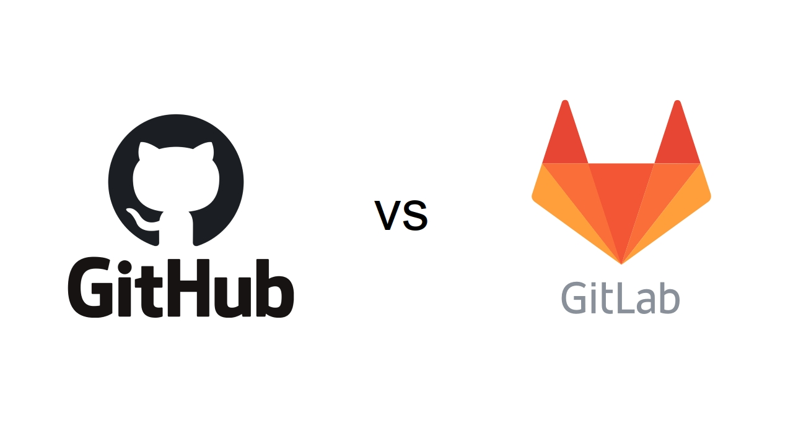
• GitHub was developed by Chris Wanstrath, Tom Preston-Werner, P. J. Hyett, and Scott Chacon.
• GitHub is not open source.
• It allows users to have unlimited free repository.
• GitHub allows users to have free private repository but with maximum of three collaborators.
• It helps us create an organized document for the project.
• GitHub doesn't have this feature yet but they can check the commit history.
• It helps us create an organized document for the project.
• It is used for sharing the work in front of the public
• There is a limited private repository.
• It supports only Git version control.
• GitLab was developed by Dmitriy Zaporozhets and Valery Sizov
• GitLab is open-source for community edition. • It allows users to make public repository.
• GitLab also provides free private repository.
• GitLab is freely available and open is source for community edition
• GitLab allows users to see project development charts.
• GitLab is freely available and open is source for community edition
• It is a cloud-native application and is highly secure.
• GitLab is available with many bugs and it makes user experience sloppy.
• It is difficult to manage code reviews for the first timers.

Slide 27
Application of Github
• It Makes It Easy to Contribute to Your Open Source Projects
• Documentation
• Showcase Your Work
• Markdown (text editor)
• GitHub is a Repository
• Track Changes in Your Code Across Versions
• Integration Options GitHub can integrate with common platforms such as Amazon and Google Cloud, services such as Code Climate to track your feedback, and can highlight syntax in over 200 different programming languages.

Slide 28
Application of Github
DevOps that encourages the companies to use techniques that help developers and operations teams to work together. GitHub has played a vital role in DevOps method (Bissyande et al., 2013). Apart from these methods companies and developers had to wait for the testing feedback to know the bugs and fix them. One of the most recent methodology implemented by the companies is continuous integration (CI) and continuous development (CD).

Slide 29
Conclusion
GitHub plays a vital role in assisting projects with a large number of distributed users by providing an open development environment and a simple user-friendly interface which showcases all the activities that take place within a given project. This promotes a better understanding of the project within the team members and a better collaboration with minimal communication needs.

Slide 30
THANKYOU

